Slide 1
Abstract Expressionism
and
Color Field Painting
European Influence

Slide 2
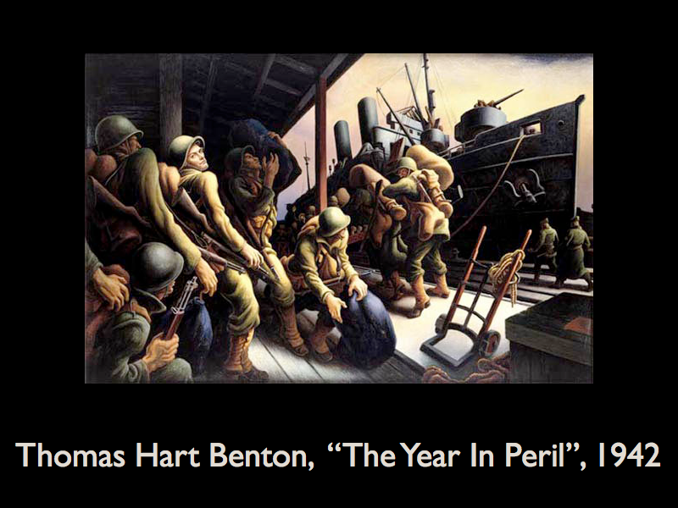

Notes:
Before the second world war the most popular style in America was called social realism. Realistic but somewhat stylized figurative works like what we see here by the artist Thomas Hart Benton. Jackson Pollock and many of the other Abstract Expressionists studied under Thomas Hart Benton or other social realists and they were very familiar with this style of art before they developed their own.

Slide 3
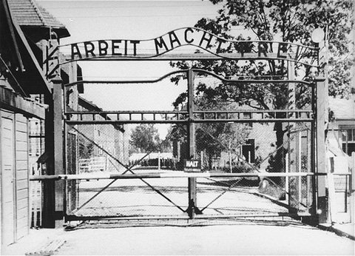
Notes:
After world war II however, the younger artists felt that a new way of making art was needed in order to try and depict the new reality, and thus another artistic crisis was born. With the realization that the Nazi's were capable of killing 6 million innocent civilians in concentration camps...

Slide 4
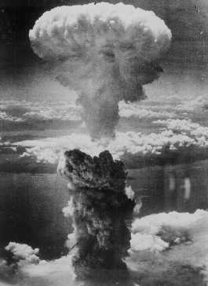
Notes:
Or that we now had a bomb that could kill 140,000 and weren't afraid to use it, these artists were confronted with a deep realization of humanities responsibility if we were to survive on this planet. This is exactly what Sartre was talking about when he says as humans we are condemned to be free and to bear the responsibility for that freedom.

Slide 5
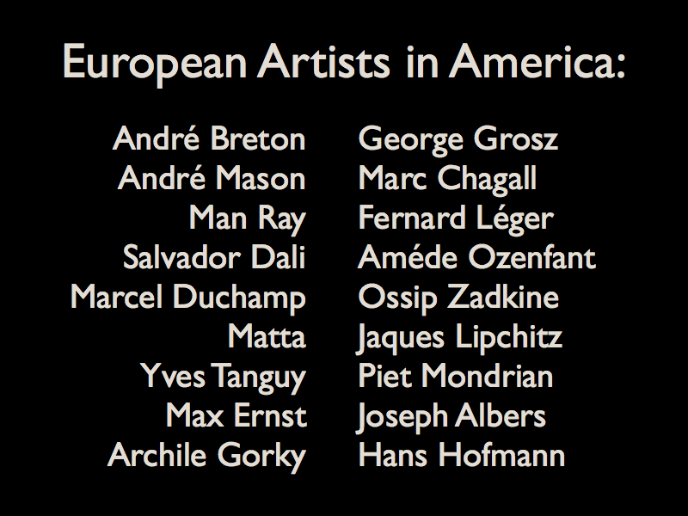
Notes:
Right before and during the second world war there were dozens and dozens of artists who came over from Europe and spend time in New York. Here's just a short list of some of the more famous artists who had a huge influence on American artists. I am going to concentrate on just two artists who came over from Europe and spent the remainder of their lives in the United States.

Slide 6
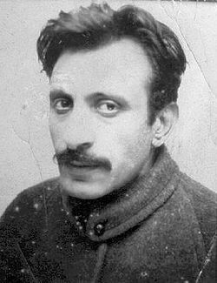
Arshile Gorky
Notes:
The first one is Arshile Gorky. Just as he changed his name, he was a very colorful figure who would make up elaborate stories about his past which he would tell at parties. He also had a several periods in his life where he suffered a very deep depression.

Slide 7
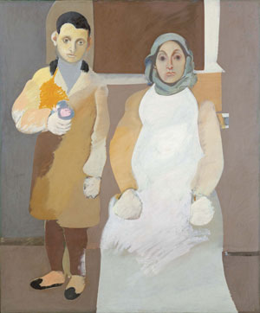
Notes:
Here is a painting that Gorky spent years working on. It was based on the only photograph he had of his mother from when he was a child. Gorky came from the Armenian part of turkey that suffered a genocide during the first world war. His mother died of starvation while they were fleeing Turkey, and he was left on his own to try to make it to America to find his father and older sister. You can see the influence of Picasso's work in this piece in the way that he's placed the figures in space, and much of Gorky's earlier work bears a resemblance to one or another artist who’s work he was studying at that time. While the faces are very carefully and realistically rendered, the rest of the painting devolves into more organic abstract shapes.

Slide 8
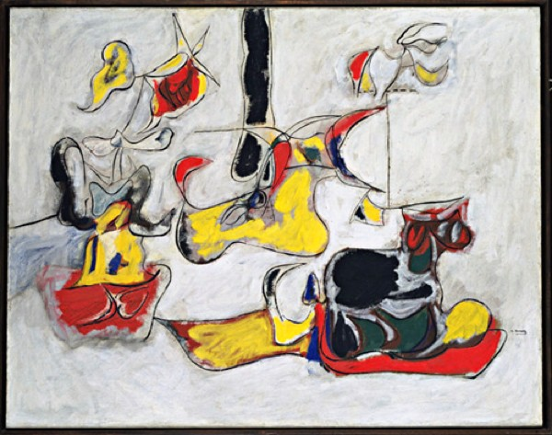
Notes:
When Gorky discovers his own style, it is definitely abstract, but his compositions are still based on realistic elements that have been abstracted to the point of no longer being recognizable. If we look at the left-hand side of this canvas we can almost make out something that looks like a figure with a red face and perhaps yellow hair, two black arms etc. And we see that the biomorphic shapes that were making up the bodies in the earlier portrait are very similar to the shapes that we see in this painting.

Slide 9
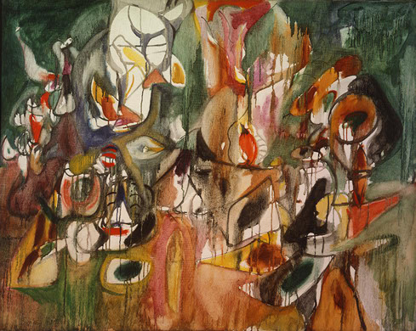
Notes:
One of his friends, another European artist named Matta, suggested that Gorky try using turpentine to thin down his paints and some of the later paintings are much more fluid and transparent like this one. If we look in the background we still see those same biomorphic shapes. Now Matta was one of the surrealists and wanted to use this flowing paint as a way to sort of tap into the subconscious.

Slide 10
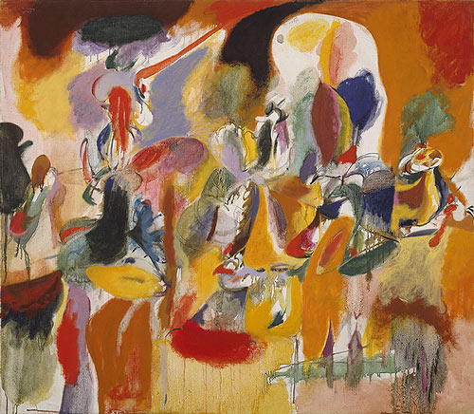
Notes:
Even though Matta and Gorky's paintings exhibit some similar shapes, their attitude towards painting remained very different. Even in painting like this one Gorky always planned his paintings out before hand and knew where the shapes were going to be. For Gorky it was important that art remained a product of the thinking mind, he felt constant spontaneity was just chaos.

Slide 11
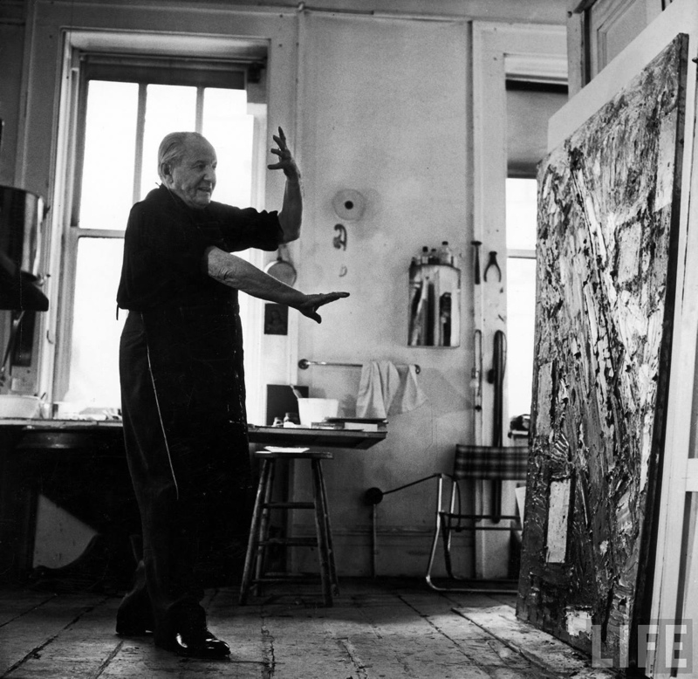
Hans Hofmann
Notes:
Hans Hofmann was a very different kind of painter thing Gorky although they were both extremely influential on the abstract expressionists. Hofmann came over from Germany and started teaching in American art schools. Nearly half of all the abstract expressionists studied under Hans Hofmann at one time. He spent most of his time teaching though and didn't have his first solo exhibition until late in life. We are going to concentrate on the term 'push pull' that Hans Hoffman used often to describe his painting technique. Before we go on I want you to look at this picture because I think his two arms demonstrate this idea very clearly, with the one pushing towards canvas any other one pulling away. Also we can see clearly here just how thick the paint on the canvas is, something that we won't necessarily be able to see as we look at the canvases in color straight on.

Slide 12
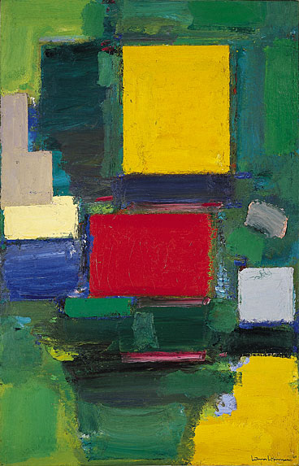
Notes:
His idea of 'push pull' comes from the basic tension set up in a picture when some shapes seem to come forward off the canvas, as others recede backwards into space. He used basic techniques that artists had been aware of for hundreds of years, such as warm or light colors appearing to come forward while dark and cool colors seem to go back. But what makes these abstract painters different is that they believed just the relationships between color and shape alone were interesting enough to create a finished artwork. In this painting it is immediately clear that the red square and the yellow square feel as if their warm colors are floating off the canvas and above the cooler green and blue background. In the lower right corner however there is a tension that is generated by the yellow color that appears as if it is pushing up from behind the green, and trying to float in place with the similarly yellow colored square. Also on the left hand side we have an L-shaped gray area that sits slightly on top of a more warm ivory colored square. This ivory colored square wants to advanced towards us off the canvas and yet is pinned down by the gray square. It is the tension in our minds as we try to resolve the shapes and where they fit into space which generates interest in this canvas.

Slide 13
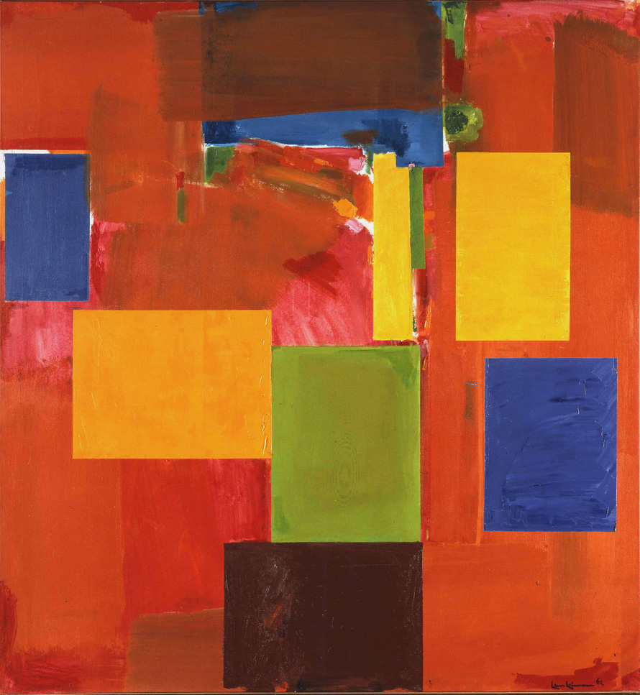
Notes:
Here's another piece where we can also see this same idea of push and pull being demonstrated. The colors have been reversed from the last painting and the cool blues and greens are now in squares sitting on top of the warm orange and red background. This again creates an interesting tension. If we just pay attention to the shapes on the canvas, all the colored rectangles seem to float in the same plane in front of the canvas. The blue square at the top interrupts this reading however, because it is pinned behind the swash of brown. Now if tell our minds to pay attention to color, the dark blue squares can also look like deep holes punched into the surface, almost like windows looking out to a deep blue sky. The warm yellow still float towards us, and the grouping of a green, yellow and brown square, because they are touching, insist on staying in the same plane, despite the colors telling our minds that they shouldn't be.

Slide 14
Images:
Thomas Hart Benton, Embarkation, 1942
The Gates of Auschwitz Concentration Camp, 1940-45, Annexed Poland
The Bombing of Hiroshima, Japan
Archile Gorky:
Mother and Son, 1936
Garden In Sochi, 1943
Milkweed, 1944
Water of the Flowery Mill, 1956
Hans Hofmann
The Gate, 1959
Sanctum, 1962
Notes:
Thomas Hart Benton, Embarkation, 1942The Gates of Auschwitz Concentration Camp, 1940-45, Annexed PolandThe Bombing of HiroshimaArchile Gorky: Mother and Son, 1936 Garden In Sochi, 1943 Milkweed, 1944 Water of the Flowery Mill, 1956Hans Hofmann The Gate, 1959 Sanctum, 1962

